Slide 1

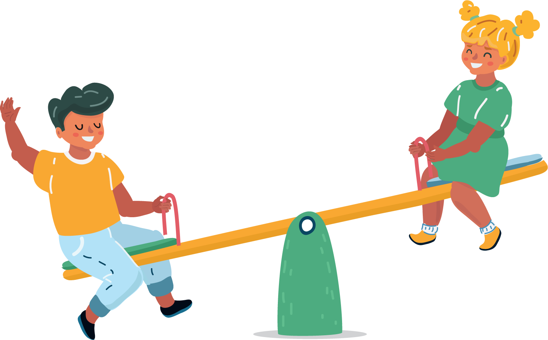

To Find
Life Balance
lausd.org/human-relations

Slide 2
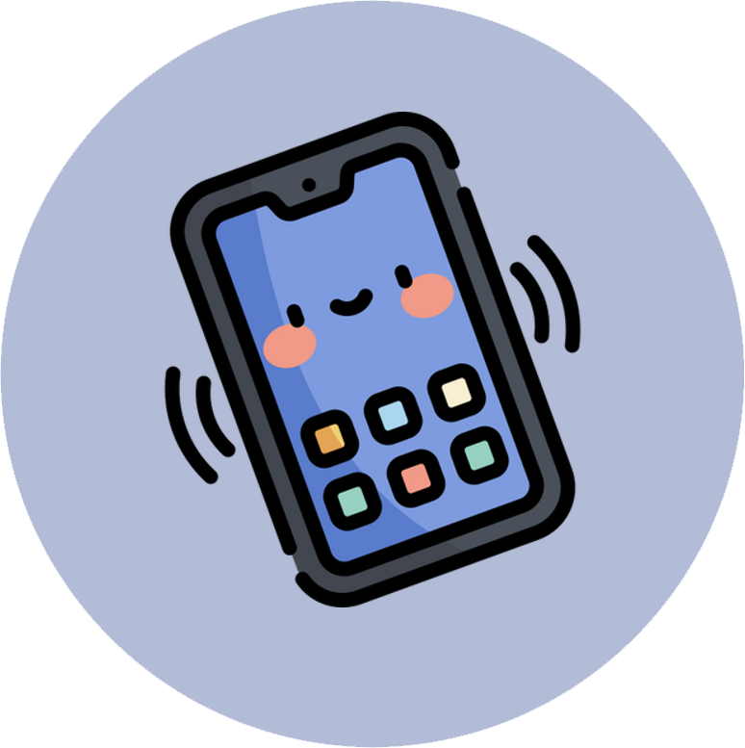

Would You Rather
Be on your device
Read a book
lausd.org/human-relations

Slide 3

What Is Media?
There are lots of different types of media.
You probably already accessed some kind of media today. Some types of media include:
Movies/TV Shows
Music / Music Videos
Books/Comic Books
Video Games
Social Media Apps
lausd.org/human-relations

Slide 4
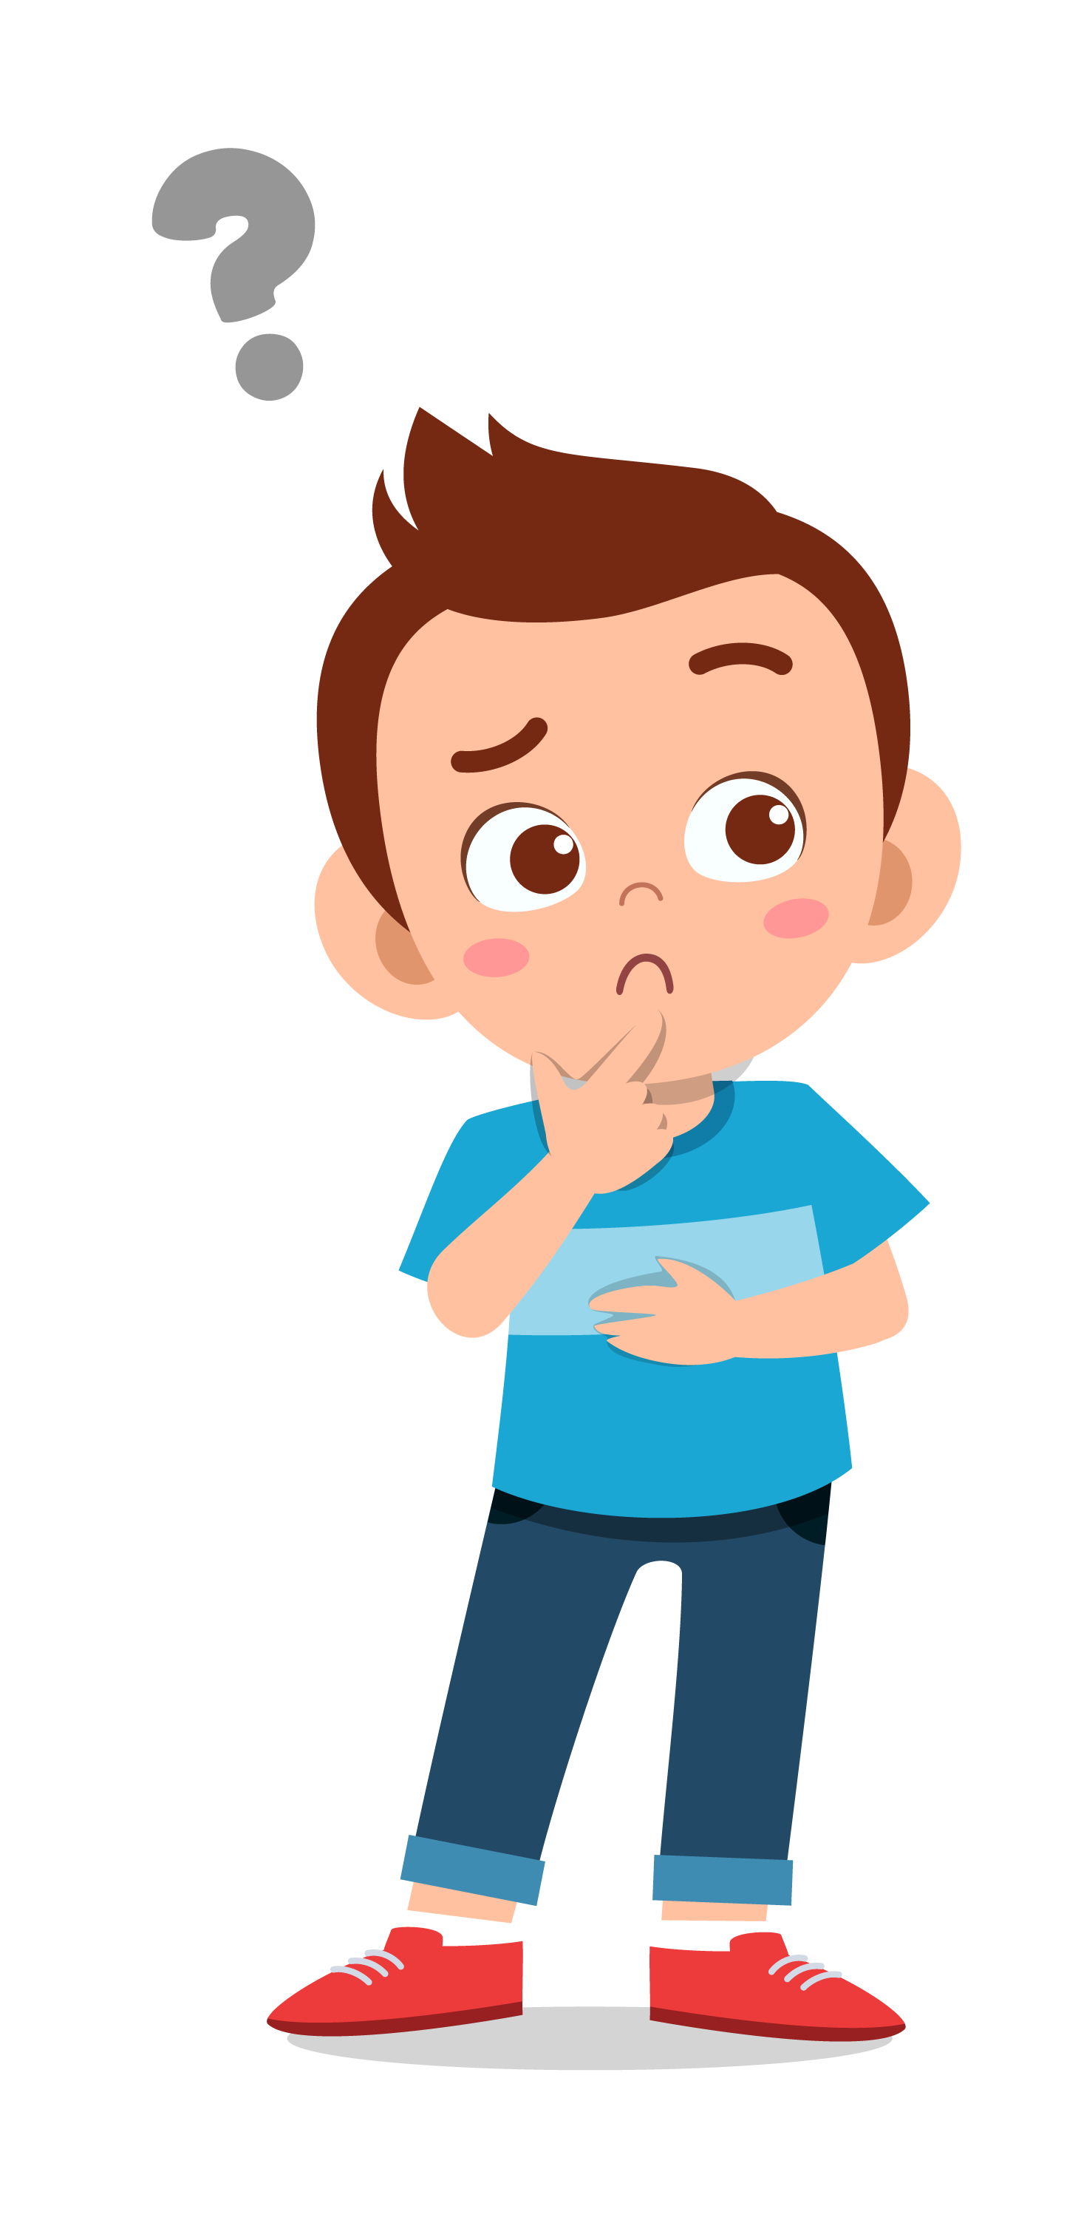


Pair Share
What type of media have you already used today?
What type of media do you prefer?
lausd.org/human-relations

Slide 5


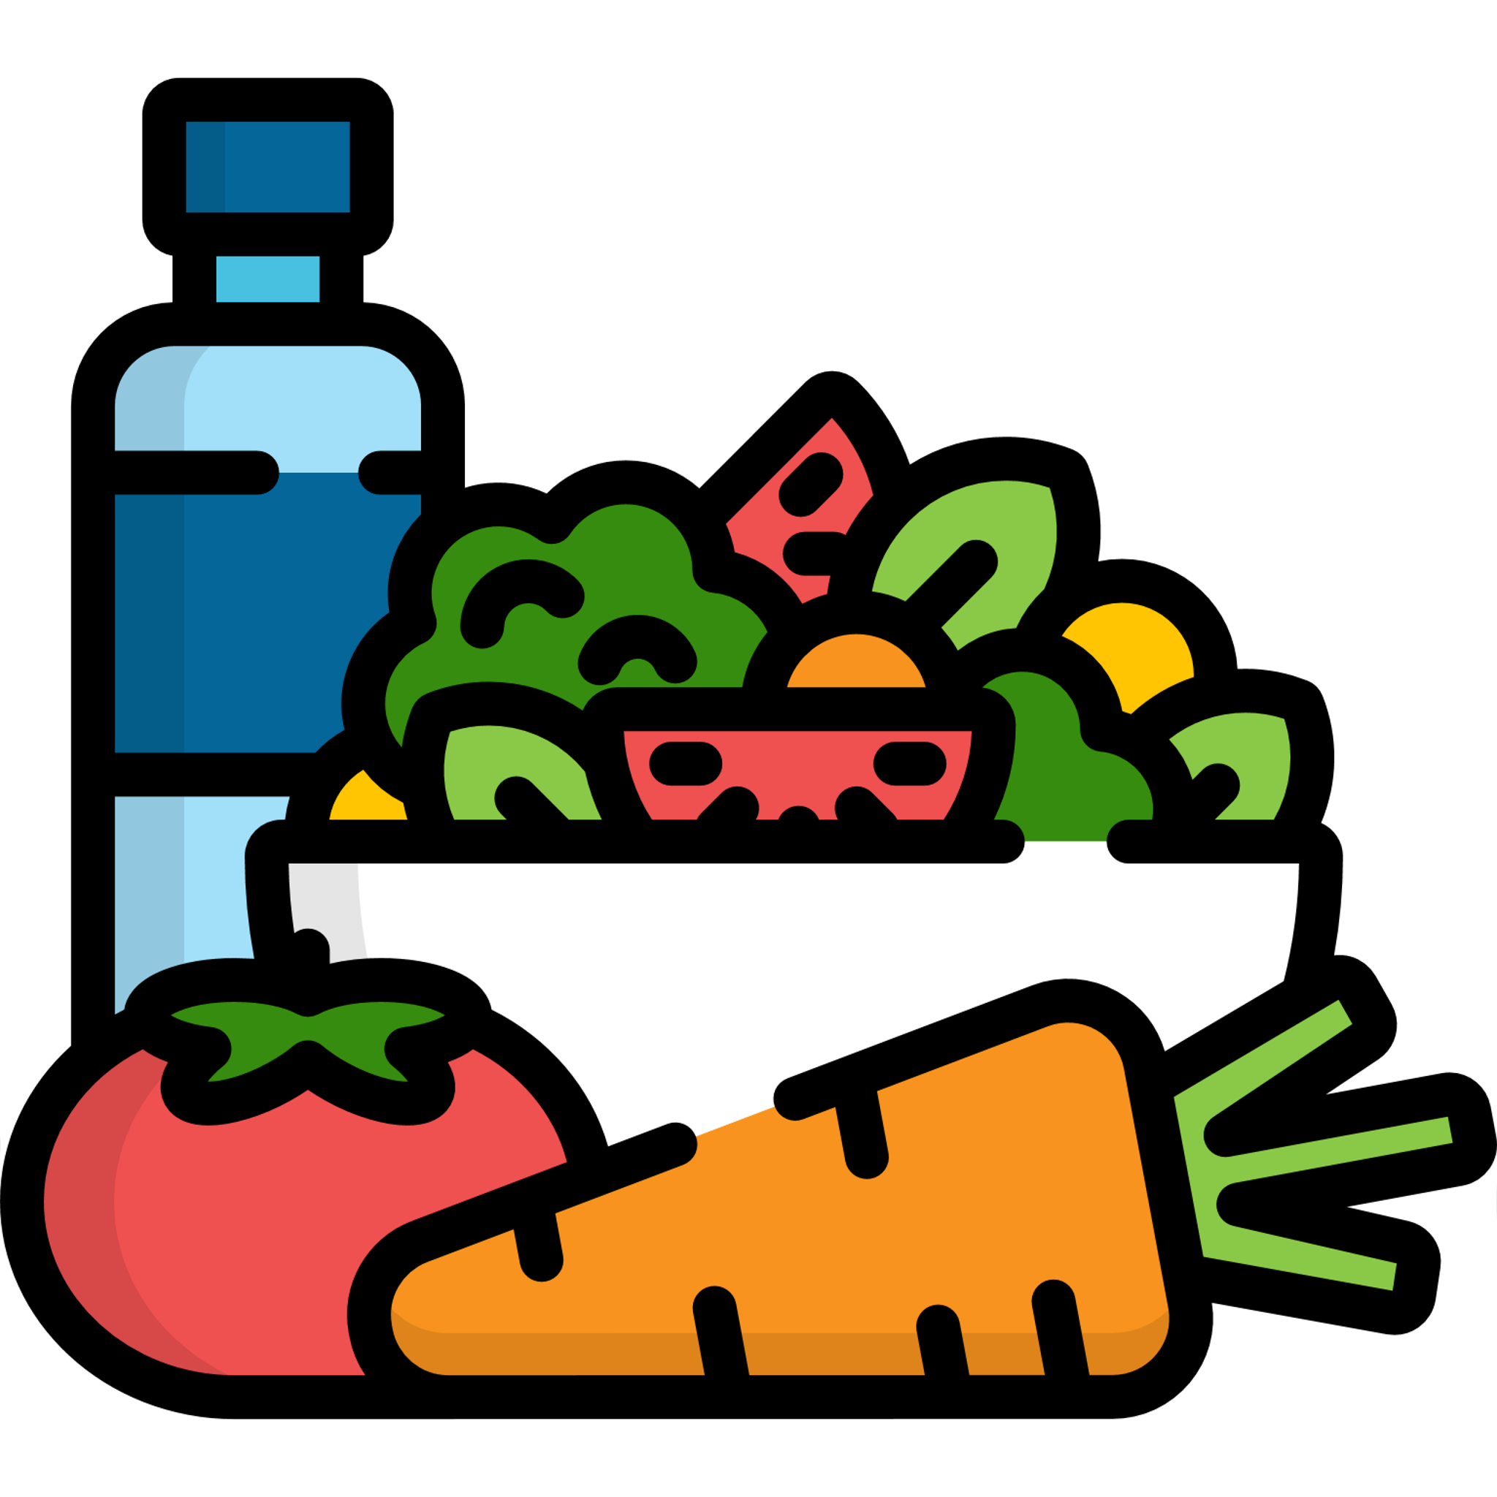

Making Choices
Every day we make choices, like:
What we eat
What we wear
What kind of media we use
These choices impact how we feel.
lausd.org/human-relations

Slide 6





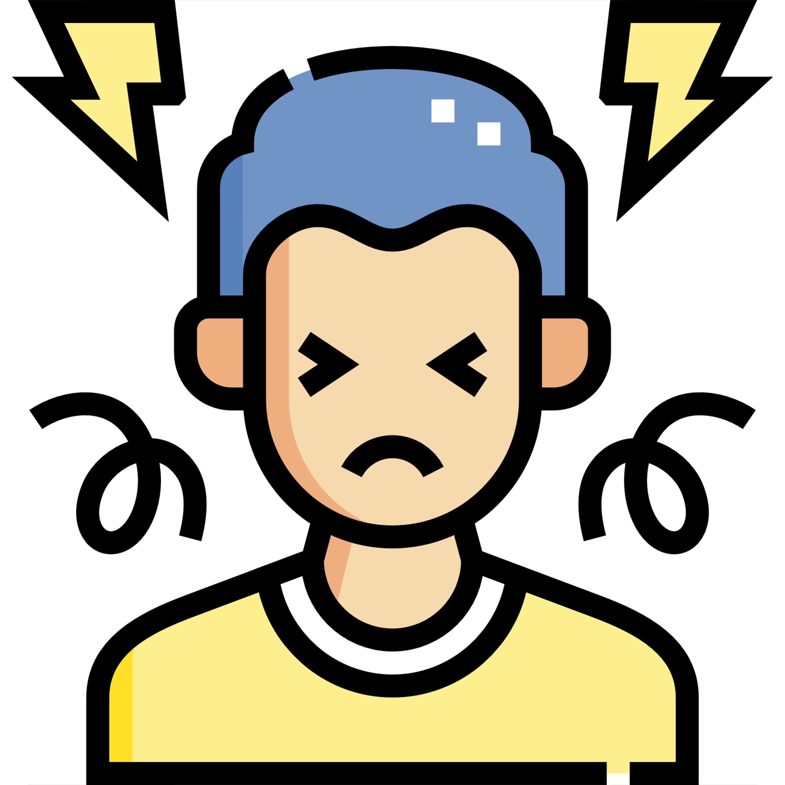

Our Choices Impact Our Feelings
Media can cause us to feel a lot of different things, like:
Happy
Curious
Excited
Loved
Scared
Stressed
Angry
lausd.org/human-relations

Slide 7

Pair Share
You already shared your favorite type of media.
How does you feel when you are using it?
lausd.org/human-relations

Slide 8


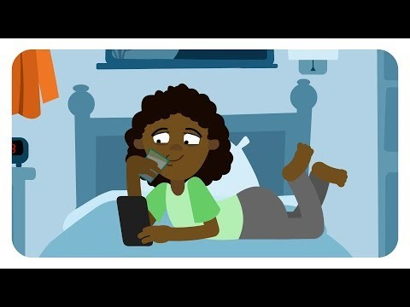
Start With Media Balance
lausd.org/human-relations
Notes:
https://www.youtube.com/watch?v=wStFn7OwVII

Slide 9
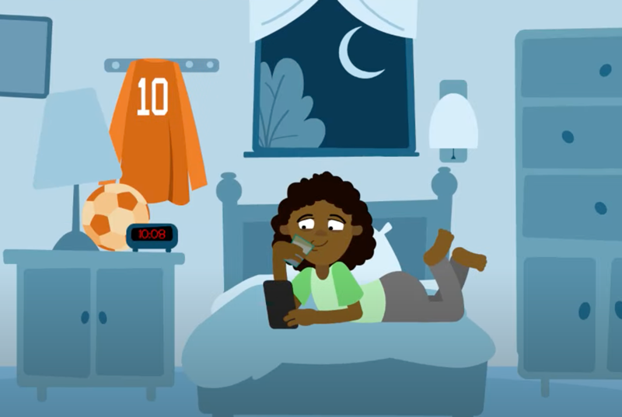
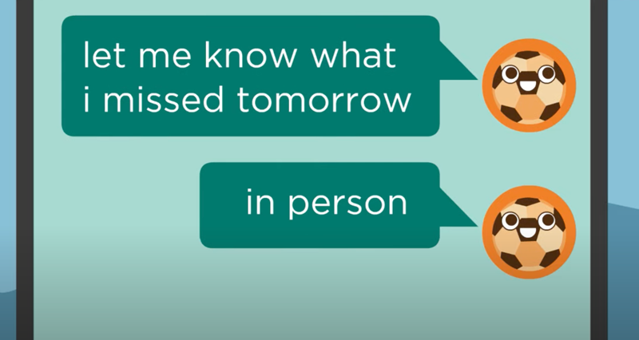
Pair Share
Talk with your partner about what you just saw in the video. Has anything like that ever happened to you?
How did you handle it?
Are you happy with how you handled it?
Is there something you could have done differently?
lausd.org/human-relations

Slide 10
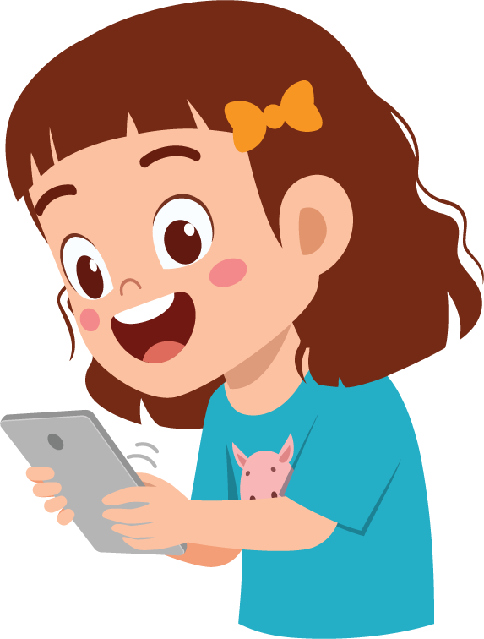
Media Balance
Media Balance means making choices that will help us feel healthy and happy.
Some things to think about:
What type media you choose
What time you choose to use it
How much you choose to consume
How these choices make you feel
lausd.org/human-relations

Slide 11
Life Balance
Making healthy choices is going to look different for everyone.
It is important to remember that there is an entire world outside of media.
We want to be sure we balance our life in a healthy way.
Sometimes that means the best choice is no media at all.
lausd.org/human-relations

Slide 12
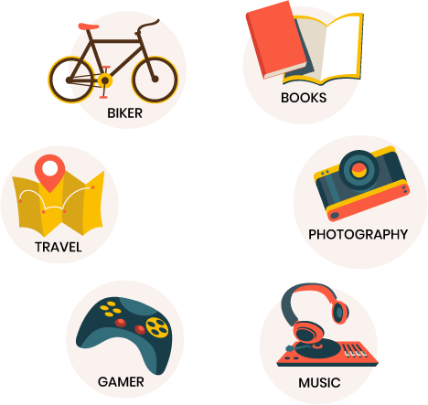
Pair Share
Other than media, what are some hobbies or interests that you have?
lausd.org/human-relations

Slide 13
Our Choices Impact Our Feelings
Just like media balance, life balance is going to look different for everyone.
We all have different priorities:
School
Sports
Friends
Social Media
Family
Religion
lausd.org/human-relations

Slide 14
How To Find Balance
Finding life balance means we don't get too deeply invested in any one of those things.
It is healthy to make choices that allow us to experience all different kinds of things. This way our bodies and brains can continue to learn and grow!
lausd.org/human-relations

Slide 15

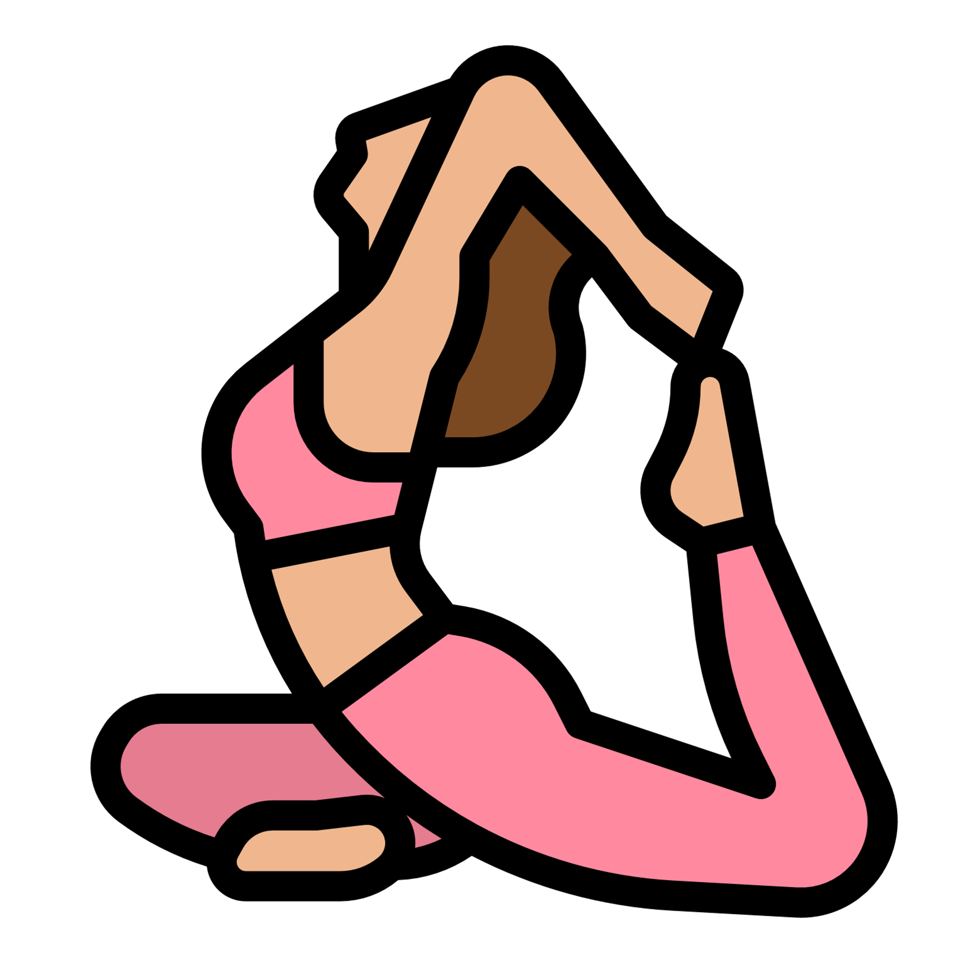



Check Out
What will you do for yourself today?
Drink a glass of water
Try yoga or Pilates
Eat something that makes you feel good
Listen to or make music
Take deep breaths
lausd.org/human-relations

Slide 16
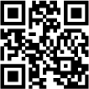
Committed to fostering a safe and respectful District, school and community culture where the seeds of peace and justice are down so that all students and staff can lead safe, purposeful and academically fruitful lives.
Connect with us at bit.ly/LAUSD-HRDE
lausd.org/human-relations

